Slide 1
Security and Authentication In Documentum
Notes:
Place the audio notes for this slide here

Slide 2

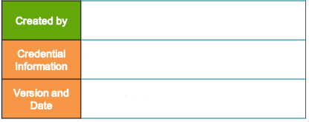
Veerendar(609673)
Enterprise Content Management Competency
V 0.1, 12th February 2018

Slide 3
Security Overview

Slide 4
Security Overview
Documentum security
At a high level, the security model in Documentum is similar to that used in contemporary enterprise applications.
There are resources (information, objects) that need to be secured, there are operations that can be performed on the resources, and there are users who wish to perform these operations.
The security configuration defines what is allowed for various combinations of users, operations, and resources.

Slide 5
Agenda
Object Security/Permissions
Folder Security
Permission Sets
Alias sets and aliases
Useful Queries : Object Security
Test Your Knowledge

Slide 6
Object Permissions

Slide 7
Object Permissions
Access to folders and documents in a repository is subject to an organization’s security restrictions.
All content in the repository is associated with object permissions, which determines the access users have to each object in the repository such as a file, folder, or cabinet and governs their ability to perform specific actions.
There are two categories of object permissions:
Basic: Required for each object in the repository
Extended: Optional

Slide 8

Object Permissions - Basic
Basic Permissions
Basic permissions grant the ability to access and manipulate an object’s content.
The seven basic permission levels are hierarchical and each higher access level includes the capabilities of the preceding access levels.
For example, a user with Relate permission also has Read and Browse.

Slide 9
Object Permissions - Basic
Basic Permission | Description
None | No access to the object is permitted
Browse | Users can view the object’s properties but not the object’s content.
Read | Users can view both the properties and content of the object
Relate | Users can do the above and add annotations to the object.
Version | Users can do the above and modify the object’s content and check-in a new version of the item (with a new version number). Users cannot overwrite an existing version or edit the item’s properties.
Write | Users can do the above and edit object properties and check in the object as the same version.
Delete | Users can do all the above and delete objects.

Slide 10
Object Permissions - Extended
Extended permissions
Extended permissions are optional, grant the ability to perform specific actions against an object, and are assigned in addition to basic permissions.
Extended permissions are not hierarchical, so each must be assigned explicitly.
Only system administrators and Superusers can grant or modify extended permissions.

Slide 11
Object Permissions - Extended
Extended Permission | Description
Execute Procedure | Superusers can change the owner of an item and use Execute Procedure to run external procedures on certain object types. A procedure is a Docbasic program stored in the repository as a dm_procedure object.
Change Location | Users can move an object from one folder to another in the repository. A user also must have Write permission to move the object. To link an object, a user also must have Browse permission on the Target Folder.
Change State | Users can change the state of an item with a lifecycle applied to it.
Change Permission | Users can modify the basic permissions of an object.
Change Ownership | Users can change the owner of the object. If the user is not the object owner or a superuser, they also must have Write permission.
Delete Object | Users can only delete the object. For example, you may want a user to delete documents but not read them. This is useful for Records Management applications where discrete permissions are common.
Change Folder Links | Users can link or unlink an object to the folder in the repository

Slide 12

Object Permissions
Additional Permissions Effects
The following object permissions are required to change an object's location:
- Move (Primary folder): WRITE and Change Location
- Move (Non-primary folder): BROWSE and Change Location
- Link: BROWSE and Change Location
- Copy: READ
The following object permissions are required to:
- Update properties with checkout: VERSION
- Update properties without checkout: WRITE
- Add a rendition to a document: WRITE
- Add comments to a PDF document: RELATE
- Change ownership if not a SUPERUSER: WRITE and Change Owner

Slide 13
Folder Security
Overview

Slide 14
Folder Security
Folder security is an additional level of security that supplements the existing repository security.
Implementing this security option further restricts allowable operations in a repository.
Folder security prevents unauthorized users from adding documents to, removing documents from, or changing contents of secured folders.
Preserves the integrity of the contents of a folder
By default Folder security is enabled for a repository
Folder security enabled by setting the folder_security attribute of the dm_docbase_config object set to 1

Slide 15


Folder security
When folder security is enabled, a user must have Write permission or Change Folder Links permission for the:
Target folder to create, import, copy, or link an object into the folder.
Source folder to move or delete an object from a folder.
Folder security only pertains to changing the contents in a folder. For example, a user with Browse permission on a folder can still check out and check in objects within the folder.

Slide 16
Folder security
The following table lists the actions affected by folder security.
Action | Requires at least Write or Change Folder Links permission for:
Create an object | Cabinet or folder in which you create the new object
Import file(s) or folder | Cabinet or folder to which you import the file(s) or folder
Move an object | Both the cabinet or folder from which you remove the object and the destination folder or cabinet
Copy an object | Destination cabinet or folder
Link an object | Destination cabinet or folder
Unlink an object | Cabinet or folder from which you unlink the object
Delete one version of a document | The document’s primary folder
Delete all versions of a document | The document’s primary folder
Delete unused versions of a document | The document’s primary folder

Slide 17
Permission Sets

Slide 18
Permission Sets
A Permission Set is a reusable permissions configuration
Assigned to objects in the repository
Determines how all users interact with an object
Permission sets describe the basic and extended
permission levels for:
- Owner (required) the object owner
- Users (optional) any number of individual users
- Groups (optional) any number of groups
- World (required) all users in the repository

Slide 19
Permission Sets
Each permission set is an ACL object on the Content Server:
Contains a list of users and groups
Contains a set of basic permissions for each user and group
Contains a set of extended permissions for each user and group
Is associated with objects by name and owner
Permission sets are only assigned to objects that are dm_sysobjects or a subtypes of dm_sysobject
In this module, the term "object" refers specifically to any dm_sysobject or subtype of dm_sysobject.

Slide 20
Permission Sets
What is an ACL?
Access Control List (ACL) is an object that implements a permission set.
It contains a list of entries describing permission levels for individuals and groups.
What is the difference between an ACL and a permission set?
ACL is just another name that is commonly used when referring to a permission set. Older versions of Documentum manuals refer to a permission sets as ACLs.

Slide 21
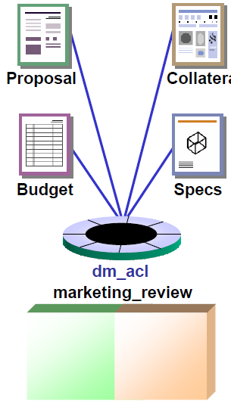
Permission Sets
Assigning Permission Sets Permission Sets
When an object is created, a default permission set is assigned to it by the Content Server
At a later time, a different permissions set can be assigned by:
- A User
- An Application
A permission set can be
assigned to any number
of objects
An object can only have one
permission set assigned to it
at any time
Notes:
Changing Permissions
Permissions on an object can be changed by the object owner, a user with SUPERUSER privilege, or any user with the Change Permission extended permission.
Renditions and Permissions
Access to renditions is determined by the permission settings on the primary content object. Renditions cannot be checked out or edited.

Slide 22

Permission Sets
Default Permission Sets
The Content Server's Default ACL configuration determines which permission set the Content Server assigns to newly created objects
The system administrator specifies one of three options for the entire repository:
User(default): the object creator's default permission set is assigned to the object
Folder: the permission set of the folder where the object is created is assigned to the object
Type: the permission set configured for the object's type is assigned to the object

Slide 23
Permission Sets
Setting Default ACL
Set the default ACL assignment by updating the default_acl attribute of dm_server_config object.
Valid values for default_acl in the dm_server_config object:
1 - folder (the object’s primary folder)
2 - type (a preferred way in type-based custom applications)
3 - user (default setting)
By default, the value for the default_acl attribute in the dm_server_config object is 3, user.
Depending upon the user permissions, the object ACL can always be changed to a different ACL at a later time.

Slide 24

Permission Sets
System and User Permission Sets
System Permission Sets are:
Created and modified by a user with SUPERUSER or SYSADMIN privileges
Owned by the repository owner(dm_dbo)
Available for use by all Content Server users
User Permission Sets are:
Created and modified by individual users
Owned by the creating user
Available only to the owner
Notes:
Who owns the permission set?
• The user creating the permission set is the permission set owner. A user with SUPERUSER
privilege can assign a different owner to the permission set.
• Any user can create a permission set for their own use, if allowed by the administrator.
dm_dbo
dm_dbo is an internal alias for the ID of the repository owner.

Slide 25
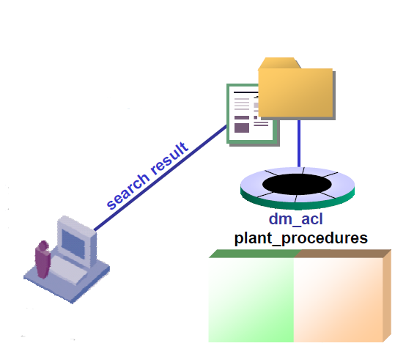
Permission Sets
Permission Sets and Folders
All cabinets and folders are assigned a
permission set
Cabinet/folder permissions do not deny access to objects
inside the folder
A user with NONE permission on a folder
cannot see the folder but can still access
objects inside the folder by searching
for them
John does not have sufficient permissions to see the folder, but by performing a search, he can access the document inside the folder (assuming he has sufficient permissions on the document).
John
Notes:
Searching for Documents in Inaccessible Folders
Documents can be found using the following methods:
• Simple Search in Webtop
• Advanced Search in Webtop
• Find Tool in Desktop
• DQL query in Documentum Administrator
Please refer to the Searching module of this course for more information about searching in the
repository.

Slide 26
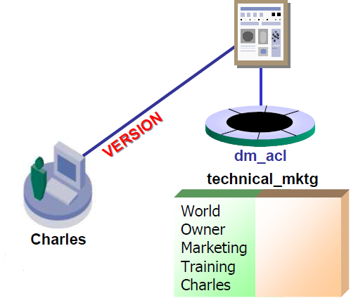
Permission Sets
Permissions Precedence
When a user has several permission levels on an object, the most permissive level takes precedence
In this example:
Charles is a member of both the Marketing and
Training groups
- Charles is not the object owner
Can Charles update
documents associated
with the technical_mktg ACL?
Yes, Charles can perform an update. Charles is referenced four times in the permission set: as a member of the Marketing and Training groups, as a member of World, and has himself. The most permissive permission level applies: VERSION.
Notes:
Access Restrictions
When Trusted Content Services (TCS) is implemented on the Content Server, Access
Restrictions can be used to limit a user's permissions level regardless of other object permission
settings.
See the Advanced Object Security Features section of this module for additional information
about Trusted Content Services.

Slide 27
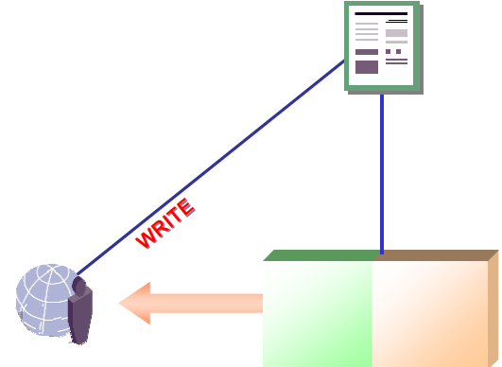
Permission Sets
SUPERUSER Privilege
A user with the SUPERUSER privilege inherits ownership of all objects, including the owner's permissions
A SUPERUSER automatically has all extended permissions, except Extended Delete,
which must be inherited or explicitly
granted
In this example:
The owner of the document
has WRITE permission
- A SUPERUSER would also
have WRITE permission on the document
SUPERUSER
Notes:
SUPERUSER Access to Objects
• When a user with SUPERUSER privilege accesses an object belonging to another user, the
SUPERUSER assumes the permissions of the object owner.
• For example: Michael is the owner of dm_document ‘Engineer Job Description’, and has
VERSION permission on that document, then Agnes (with SUPERUSER privilege) assumes
VERSION permission on that same document.

Slide 28
Alias Sets and Aliases

Slide 29
Alias sets and Aliases
An alias set is an object that defines one or more aliases and their corresponding values. An alias is a placeholder for user names, group names, or folder paths. Content Server provides various alias sets that are installed by default.
Aliases can be used in:
SysObjects or SysObject subtypes, in the owner_name, acl_name, and acl_domain properties
ACL template objects, in the r_accessor_name property
Workflow activity definitions (dm_activity objects), in the performer_name property
A Link or Unlink method, in the folder path argument

Slide 30
Alias sets and Aliases
Default alias sets
The Content Server adds two default aliases to a permission set:
dm_owner: Represents the owner of the permission set.
dm_world: Represents all repository users.
Note:
• You cannot delete dm_owner or dm_world aliases from a permission set.
• dm_owner and dm_world are just containers used by server to determine the permissions defined for owners and other users in the repository. This is internal to DFC and server and any end user application should not use them to set permits for ACLs.

Slide 31
Alias sets and Aliases
Any user can create an alias set. However, only the owner of the alias set or a superuser can change or delete an alias set. If the server API is used, the constraints are different:
• To change the owner of an alias set, you must be either the owner of the alias set or have superuser privileges.
• To change other properties or to delete an alias set, you must be the owner of the alias set or a user with system administrator or superuser privileges.

Slide 32
Useful Queries : Object Security
Display the folder security setting for this repository (0=disabled, 1=enabled):
select folder_security from dm_docbase_config
Show the default ACL mode for the Content Server:
select default_acl from dm_server_config
List the objects associated with this permission set:
select object_name from dm_sysobject
where
acl_name = 'internal_reviewers‘ and acl_domain = 'dsmith'
List the permission sets that specifically reference this user:
select object_name, owner_name from dm_acl
where
any r_accessor_name =‘fred’
Notes:
SUPERUSER Privilege
The above queries require the SUPERUSER privilege.
Object Types and Properties
Refer to the Content Server Object Reference Manual for a complete list of Documentum object

Slide 33
Test Your Knowledge / Recap
Which permission level allows you to update an object's properties without checking out the object?
True/False: NONE permission on a cabinet prevents access to documents and folders inside the cabinet.
Custom permission sets are created when a:
A) SUPERUSER deletes a permission set
B) User makes changes to an object's permissions
C) User assigns a permission set to an object
D) System Administrator creates a permission set
True/False: When folder security is enabled, a user needs WRITE permission on the folder to link documents into the folder.
Notes:
1. WRITE permission.
2. False. Although the folder will not be visible to a user with NONE permission, the user can
still retrieve documents in the folder by searching for them.
3. B.
4. True. Creating a link in a folder would alter the contents of a folder.

Slide 34
You have successfully completed
Object Security Fundamentals
Notes:
Place the audio notes for this slide here

